Slide 1
Object-Oriented Programming
Mohammad Salman
Dean’s Fellow

Slide 2
Logistics
Lab quiz when?
Coming Wednesday or the week after that?
Coming Wednesday is the lab quiz.
All topics before operator overloading (this week’s topics) included.
We will have five lab quizzes in total in this course.

Slide 3
Operator Overloading
An example before we continue on with this topic.
https://www.learncpp.com/cpp-tutorial/introduction-to-operator-overloading/

Slide 4
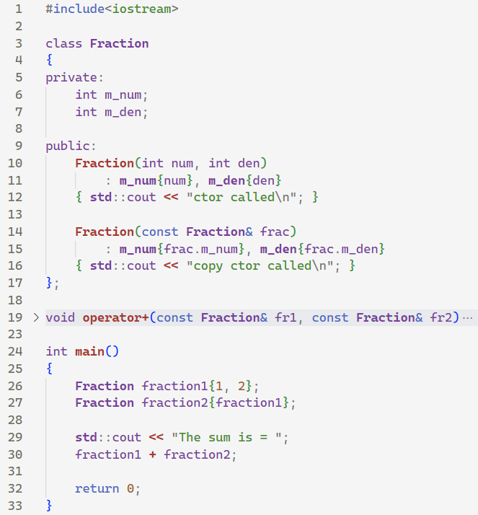
What will be the output of this program?
The function is collapsed; the implementation is there.

Slide 5
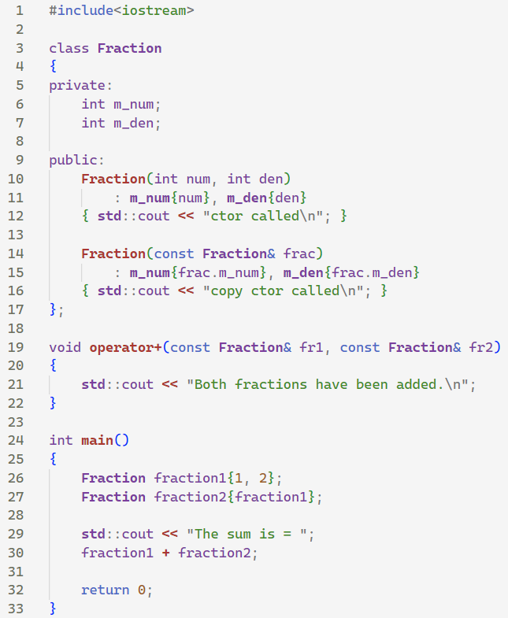
The implementation of your operator overload should be intuitive and make sense.
Irresponsible implementation of operator overloads can serve to confuse your future self and other programmers working with your code base.
e.g. if you have two string objects, what will their subtraction indicate?
MyString s1; MyString s2;
std::cout << s1 – s2;

Slide 6
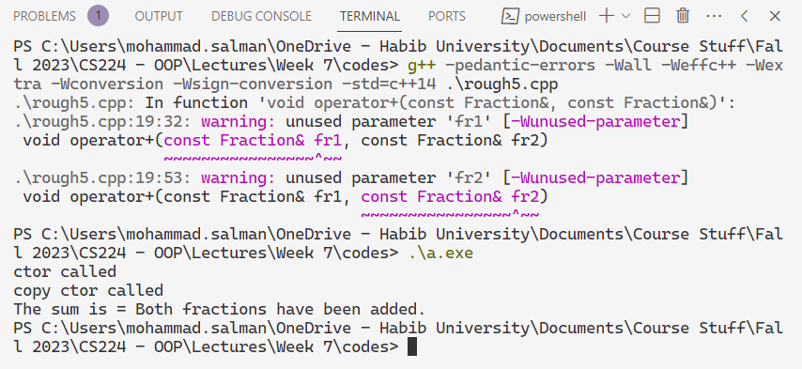

Slide 7
FYI
Note that doing
fraction1 + fraction2;
triggers a call to operator+().
You could explicitly call this operator overload as well.
operator+(fraction1, fraction2);
This will work as well.

Slide 8
Friend Functions
The class perceives the function marked as friend as its friend.
Therefore, the class allows this function to access the private and protected members (attributes and methods) of its objects.
This technique can save you from unnecessarily adding many getters and setters.
Notes:
The friend declaration is not affected by access controls, so it does not matter where within the class body it is placed.
A function can be a friend of more than one class at the same time.

Slide 9
Writing Operator Overloads Using Class Member Functions
These functions will be part of your class.
https://www.learncpp.com/cpp-tutorial/overloading-operators-using-member-functions/

Slide 10
class Fraction
{
private:
int m_num;
int m_den;
public:
Fraction(int num, int den)
: m_num{num}, m_den{den}
{}
int getNum() const { return m_num; }
int getDen() const { return m_den; }
void show() const
{ std::cout << m_num << '/' << m_den << '\n'; }
};
int main()
{
Fraction fraction1{1, 2}; // 1/2
Fraction fraction2{fraction1}; // 1/2
Fraction f3{ fraction1 * fraction2 };
f3.show();
return 0;
}
// Compiler's interpretation
operator*(fraction1, fraction2);
// Not part of class; it's present in the global scope.
Fraction operator*(const Fraction& fr1, const Fraction& fr2)
{
int numRes = fr1.getNum() * fr2.getNum();
int denRes = fr1.getDen() * fr2.getDen();
Fraction res{numRes, denRes};
return res;
}

Slide 11
The reason we need a single explicit parameter is because the overload is a member function.
To call a member function, you need to call it with an object of that class.
The first operand gets passed in as the implicit object, and
The second operand gets passed in as the explicit parameter.
// In main()
fraction1 * fraction2
// Compiler’s interpretation
fraction1.operator*(fraction2)
class Fraction
{
private:
int m_num;
int m_den;
public:
// Other stuff here (omitted due to lack of space) Fraction operator*(const Fraction& fr2) const
{
int numRes = getNum() * fr2.getNum();
int denRes = getDen() * fr2.getDen();
Fraction res{numRes, denRes};
return res;
}
};

Slide 12
Note
This first const is only there because the member function has been marked const.
// In main()
fraction1 * fraction2
// Compiler’s interpretation
fraction1.operator*(fraction2)
// Member of class Fraction
Fraction operator*(const Fraction& fr2) const
{
int numRes = getNum() * fr2.getNum();
int denRes = getDen() * fr2.getDen();
Fraction res{numRes, denRes};
return res;
}
const Fraction* const this
&fraction1
Fraction fraction1
m_num | m_den
// Methods
Fraction fraction2
m_num | m_den
// Methods
fr2
Notes:
Because one of the objects is implicit, getNum() and getDen() are being accessed using this.

Slide 13
Is there a need to use getters in the implementation of this function?
No. It is a member of the class.
As a member of the class, it can access the private members of the objects of this class.
// Member of class Fraction
Fraction operator*(const Fraction& fr2) const
{
int numRes = getNum() * fr2.getNum();
int denRes = getDen() * fr2.getDen();
Fraction res{numRes, denRes};
return res;
}
Fraction operator*(const Fraction& fr2) const
{
int numRes = m_num * fr2.m_num;
int denRes = m_den * fr2.m_den;
Fraction res{numRes, denRes};
return res;
}

Slide 14
When overloading an operator using a member function…
The left operand becomes the implicit *this object.
All other operands become (explicit) function parameters.

Slide 15
This is multiplication of a Fraction with an int.
The fraction1 object is pointed by this, and the integer x gets passed by value into num.
class Fraction
{
private:
int m_num;
int m_den;
public:
Fraction(int num, int den)
: m_num{num}, m_den{den}
{}
int getNum() const { return m_num; }
int getDen() const { return m_den; }
Fraction operator*(int num) const
{
int numRes = m_num * num;
int denRes = m_den;
Fraction res{numRes, denRes};
return res;
}
void show() const
{ std::cout << m_num << '/' << m_den << '\n'; }
};
int main()
{
Fraction fraction1{1, 2}; // 1/2
int x{5};
Fraction f3{ fraction1 * x };
// Compiler's interpretation
// fraction1.operator*(x)
f3.show();
return 0;
}

Slide 16
How will you write an overload for operator* so that int is the first parameter and Fraction is the second parameter?
You cannot.
Need a non-member function.
class Fraction
{
private:
int m_num;
int m_den;
public:
Fraction(int num, int den)
: m_num{num}, m_den{den}
{}
int getNum() const { return m_num; }
int getDen() const { return m_den; }
Fraction operator*(int num) const
{
int numRes = m_num * num;
int denRes = m_den;
Fraction res{numRes, denRes};
return res;
}
void show() const
{ std::cout << m_num << '/' << m_den << '\n'; }
};
int main()
{
Fraction fraction1{1, 2}; // 1/2
int x{5};
Fraction f3{ x * fraction1 };
// Compiler's interpretation
// fraction1.operator*(x)
f3.show();
return 0;
}

Slide 17
This is what you have.
As a member function overload, this is what the interpretation should be.
But this doesn’t make sense because an int is not a class in C++.
x * fraction1
x.operator*(fraction1)
As such you need to overload operator*() as a global (or a non-member) function.
So that we have this interpretation.
x * fraction1
operator*(x, fraction1)

Slide 18
Can you define the overload for operator<<() as a member function of class Point (or any user-defined class for that matter)?
std::ostream& operator<< (std::ostream& out, const Point& point)
{
out << "Point(" << point.getX() << ", " << point.getY() << ", " << point.getZ() << ')';
return out;
}
If you wanted this to be defined as a member function, the interpretation would be as follows.
std::cout << point1;
(std::cout).operator<<(point1);
So operator<<() shouldn’t be a member of class Point.
Now, we would need to somehow modify the class ostream (to which cout belongs to).
Since ostream is built into the language, we cannot modify it.
Therefore, overloads for operator<<() and for operator>>() (not an exhaustive list) have to be defined as normal functions.

Slide 19
When overloading an operator using a member function…
The left operand becomes the implicit *this object.
All other operands become (explicit) function parameters.
The overloaded operator must be added as a member function of the left operand.
Use the following examples to understand why this point is important.
x * fraction1
x.operator*(fraction1)
std::cout << point1;
(std::cout).operator<<(point1);
Notes:
Typically, we won’t be able to use a member overload if the left operand is either not a class (e.g. int), or it is a class that we can’t modify (e.g. std::ostream).

Slide 20
Operator Overloading
There are some operators which must be overloaded as normal (non-member) functions.
There are some operators which can be overloaded in both ways.
There are some operators which must be overloaded as member functions (they must be part of the class).

Slide 21
Operator Overloading
There are some operators which must be overloaded as member functions (they must be part of the class).
Assignment ( = )
Subscript ( [] )
Function call ( () )
Member selection ( -> )
And some others.
This is the requirement of C++.
Notes:
The typecast operator in your lab can only be implemented as a member function of your class.

Slide 22
Overloading operator=

Slide 23
The Copy Assignment Operator operator=
It is used to copy values from one object to another already existing object.
It must be overloaded as a member function.

Slide 24
Assignment is done from right to left.
Keep this in mind when chaining the assignment operator.
int x = 5;
int y = 6;
int z = 7;
x = y = z;
std::cout << x << ' ' << y << ' ' << z;
Notes:
Output will be
7 7 7

Slide 25
Copy Constructor vs. operator=
The purpose of the copy constructor and the copy assignment operator are almost equivalent -- both copy one object to another.
However, the copy constructor initializes new objects, whereas the assignment operator replaces the contents of existing objects.
Note that the copy ctor will be called when you pass or return objects by value because new objects are being created.

Slide 26
Just like before, we would need to provide the overload for operator= (as a class member) for this to work.
fiveThirds.operator=(4)
class Fraction
{
private:
int m_num;
int m_den;
public:
Fraction(int num, int den)
: m_num{ num }, m_den{ den }
{}
Fraction(const Fraction& fr)
: m_num{ fr.m_num }, m_den{ fr.m_den }
{}
friend std::ostream& operator<<(std::ostream& out, const Fraction& f1); };
std::ostream& operator<<(std::ostream& out, const Fraction& f1)
{
out << f1.m_num << '/' << f1.m_den;
return out;
}
int main()
{
Fraction fiveThirds{ 5, 3 };
fiveThirds = 4;
return 0;
}

Slide 27
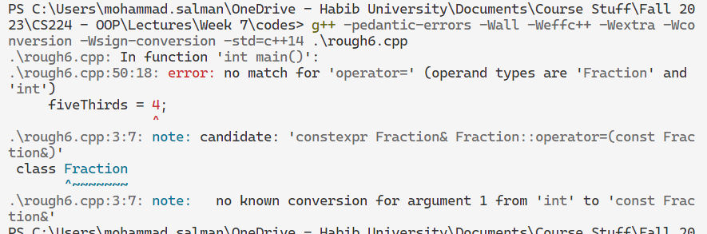
Currently, you will run into a compile-time error.
There is a nuance here that could make this work without providing the overload, but we will have to digress from the main topic. For the interested folks, the nuance relates to implicit type conversion of the integer into the object itself.
Notes:
Basically, if you ctor only took one argument, fiveThirds = 4 would have used 4 to create a Fraction object and then copied that over to fiveThirds.
This is my hypothesis.
The way to stop the above behavior then is to use the explicit keyword with your constructors to stop this implicit conversion. Cherno also has a video on this.

Slide 28
This, however, works just fine.
The compiler provides you with an overload for operator= that works with objects of the same class.
f.operator=(fiveThirds)
int main()
{
Fraction fiveThirds{ 5, 3 };
Fraction f{ 1, 2 };
std::cout << f << '\n';
f = fiveThirds;
std::cout << f;
return 0;
}
class Fraction
{
private:
int m_num;
int m_den;
public:
Fraction(int num, int den)
: m_num{ num }, m_den{ den }
{}
Fraction(const Fraction& fr)
: m_num{ fr.m_num }, m_den{ fr.m_den }
{}
friend std::ostream& operator<<(std::ostream& out, const Fraction& f1); };
Notes:
Remove the implementation of operator<< to reduce stuff on the slide.

Slide 29
Fraction& Fraction::operator=(const Fraction& fr)
{
// do the copy
m_num = fr.m_num;
m_den = fr.m_den;
// return the existing object so we can chain this operator
return *this;
}
class Fraction
{
private:
int m_num;
int m_den;
public:
Fraction(int num, int den)
: m_num{ num }, m_den{ den }
{}
Fraction(const Fraction& fr)
: m_num{ fr.m_num }, m_den{ fr.m_den }
{}
// Overloaded assignment
Fraction& operator=(const Fraction& fr);
friend std::ostream& operator<<(std::ostream& out, const Fraction& f1);
};
Note
This implementation can be further improved.
For the curious minds, read the reference link (self-assignment). Otherwise, it’s fine for now.

Slide 30
Self Study
What will be the output here?
int main()
{
Fraction f1 { 5, 3 };
Fraction f2 { 7, 2 };
Fraction f3 { 9, 5 };
f1 = f2 = f3; // chained assignment
return 0;
}
class Fraction
{
private:
int m_num;
int m_den;
public:
Fraction(int num, int den)
: m_num{ num }, m_den{ den }
{}
Fraction(const Fraction& fr)
: m_num{ fr.m_num }, m_den{ fr.m_den }
{}
Fraction& operator= (const Fraction& fr);
friend std::ostream& operator<<(std::ostream& out, const Fraction& f1); };

Slide 31
Finishing the Rule of Three
Keep in mind that the compiler provides an overload for operator= if I don’t provide one.
This overload is only for the objects of that same class.
https://www.learncpp.com/cpp-tutorial/shallow-vs-deep-copying/

Slide 32
class MyList
{
private:
double* m_array;
int m_length;
public:
MyList(int length)
: m_array{ new double[length] },
m_length{ length }
{}
MyList(const MyList& ob)
: m_array{ new double[ob.m_length] },
m_length{ ob.m_length }
{
for(int i{0}; i < ob.m_length; ++i)
{
m_array[i] = ob.m_array[i];
}
}
~MyList()
{
delete[] m_array;
}
};
If you find creating either the copy ctor or the dtor, it’s recommended to create the other as well.
There is actually one more thing that you have to keep in mind.
int main()
{
MyList list1{ 5 };
{
MyList list2{ list1 };
}
return 0;
}

Slide 33
class MyList
{
private:
double* m_array;
int m_length;
public:
MyList(int length)
: m_array{ new double[length] },
m_length{ length }
{}
MyList(const MyList& ob)
: m_array{ new double[ob.m_length] },
m_length{ ob.m_length }
{
for(int i{0}; i < ob.m_length; ++i)
{
m_array[i] = ob.m_array[i];
}
}
~MyList()
{
delete[] m_array;
}
};
Will the copy ctor be called here?
No!
The two objects have already been created, I’m just copying over the attributes of list2 into list1.
int main()
{
MyList list1{ 5 };
MyList list2{ 3 };
list2 = list1;
return 0;
}
The following slide shows how list1 and list2 will look like before the assignment operation.

Slide 34


Stack Memory
Automatic Memory Allocation
Heap Memory
Dynamic Memory Allocation
double* = 0x40 | int = 5
Methods
5.1 | 9.0 | -1.4 | 3.1 | 0.0
list1
0x20
0x40
double* = 0x130 | int = 3
Methods
12.0 | 91.5 | -10.4
list2
0x130
0x100

Slide 35
class MyList
{
private:
double* m_array;
int m_length;
public:
MyList(int length)
: m_array{ new double[length] },
m_length{ length }
{}
MyList(const MyList& ob)
: m_array{ new double[ob.m_length] },
m_length{ ob.m_length }
{
for(int i{0}; i < ob.m_length; ++i)
{
m_array[i] = ob.m_array[i];
}
}
~MyList()
{
delete[] m_array;
}
};
The compiler’s provided operator= will be used, which just copies members of list1 into list2.
int main()
{
MyList list1{ 5 };
MyList list2{ 3 };
list2 = list1;
return 0;
}
What this does, is shown on the next slide.

Slide 36

Stack Memory
Automatic Memory Allocation
Heap Memory
Dynamic Memory Allocation
double* = 0x40 | int = 5
Methods
5.1 | 9.0 | -1.4 | 3.1 | 0.0
list1
0x20
0x40
This memory has been leaked!
double* = 0x40 | int = 5
Methods
12.0 | 91.5 | -10.4
list2
0x130
0x100
Additionally, we have coupled list1 and list2, and also when one object is destroyed, the other’s destruction will cause problems.
Similar problems that we saw while studying about copy ctors.
Notes:
Three problems; two are what we talked about in the copy ctors, and the third is the memory leak.

Slide 37
Therefore, we need to write our own operator= for objects of the same class (MyList in this e.g.).
It will be a member function.
Let’s think about its implementation. It can’t be just copy-pasting values of list1 into list2.
class MyList
{
private:
double* m_array;
int m_length;
public:
MyList(int length)
: m_array{ new double[length] },
m_length{ length }
{}
MyList(const MyList& ob)
: m_array{ new double[ob.m_length] },
m_length{ ob.m_length }
{
for(int i{0}; i < ob.m_length; ++i)
{
m_array[i] = ob.m_array[i];
}
}
MyList& operator=(const MyList& source);
~MyList()
{
delete[] m_array;
}
};
list2 = list1;
// Compiler's interpretation
list2.operator=(list1);
Again, there will be one nuance that I’ll be leaving out; it’s related to self-assignment as mentioned earlier.

Slide 38
This is our state before assignment. Now, let’s try to figure out the implementation for operator=.
list2 = list1;
// Compiler's interpretation
list2.operator=(list1);
Stack Memory
Automatic Memory Allocation
Heap Memory
Dynamic Memory Allocation
double* = 0x40 | int = 5
Methods
5.1 | 9.0 | -1.4 | 3.1 | 0.0
list1
0x20
0x40
double* = 0x130 | int = 3
Methods
12.0 | 91.5 | -10.4
list2
0x130
0x100

Slide 39
MyList& MyList::operator=(const MyList& source)
{
// first we need to deallocate any value that this array is holding.
delete[] m_array;
m_array = nullptr;
// because m_length is not a pointer, we can shallow copy it
m_length = source.m_length;
// m_array is a pointer, so we need to deep copy it if it is non-null
if (source.m_array != nullptr)
{
// allocate memory
m_array = new double[m_length];
// do the copy
for (int i{ 0 }; i < m_length; ++i)
{
m_array[i] = source.m_array[i];
}
}
else
{
// this->m_array is already nullptr
}
// return by reference return *this;
}
list2 = list1;
// Compiler's interpretation
list2.operator=(list1);

Slide 40


list2 = list1;
// Compiler's interpretation
list2.operator=(list1);
Stack Memory
Automatic Memory Allocation
Heap Memory
Dynamic Memory Allocation
double* = 0x40 | int = 5
Methods
5.1 | 9.0 | -1.4 | 3.1 | 0.0
list1
0x20
0x40
double* = nullptr | int = 5
Methods
list2
0x100

Slide 41
MyList& MyList::operator=(const MyList& source)
{
// first we need to deallocate any value that this array is holding.
delete[] m_array;
m_array = nullptr;
// because m_length is not a pointer, we can shallow copy it
m_length = source.m_length;
// m_array is a pointer, so we need to deep copy it if it is non-null
if (source.m_array != nullptr)
{
// allocate memory
m_array = new double[m_length];
// do the copy
for (int i{ 0 }; i < m_length; ++i)
{
m_array[i] = source.m_array[i];
}
}
else
{
// this->m_array is already nullptr
}
// return by reference return *this;
}
list2 = list1;
// Compiler's interpretation
list2.operator=(list1);

Slide 42


list2 = list1;
// Compiler's interpretation
list2.operator=(list1);
Stack Memory
Automatic Memory Allocation
Heap Memory
Dynamic Memory Allocation
double* = 0x40 | int = 5
Methods
5.1 | 9.0 | -1.4 | 3.1 | 0.0
list1
0x20
0x40
double* = 0x200 | int = 5
Methods
5.1 | 9.0 | -1.4 | 3.1 | 0.0
list2
0x200
0x100

Slide 43
MyList& MyList::operator=(const MyList& source)
{
// first we need to deallocate any value that this array is holding.
delete[] m_array;
m_array = nullptr;
// because m_length is not a pointer, we can shallow copy it
m_length = source.m_length;
// m_array is a pointer, so we need to deep copy it if it is non-null
if (source.m_array != nullptr)
{
// allocate memory
m_array = new double[m_length];
// do the copy
for (int i{ 0 }; i < m_length; ++i)
{
m_array[i] = source.m_array[i];
}
}
else
{
// this->m_array is already nullptr
}
// return by reference return *this;
}
list2 = list1;
// Compiler's interpretation
list2.operator=(list1);
Note that when doing delete[] m_array at the very start of this function, m_array could be a nullptr.
Note that it is safe to delete a nullptr; nothing will happen.
Notes:
You can talk about packaging all of this in a separate function called deepCopy as well.

Slide 44
Self Study
Sit down and think about the implementation of a copy ctor vs. the implementation of operator=.
What are the differences?
What are the similarities?
Since the implementations are similar, you can actually create a separate private member function (called deepCopy() let’s say) and call that within your copy ctor and operator= to prevent rewriting the same code.

Slide 45
Rule of Three (finally!)
If a class requires a user-defined
destructor,
copy constructor, or
copy assignment operator,
then it probably requires all three.
If we’re user-defining any of these functions, it’s probably because we’re dealing with dynamic memory allocation.
We need the copy constructor and copy assignment to handle deep copies, and the destructor to deallocate memory.

Slide 46
Rule of Three (finally!)
Generally, it would be better to rely on the built-in classes that you have available in C++.
std::vector
std::string
They take care of memory management for you.
You should use these in your projects as well.

Slide 47
Rule of Three (finally!)
There is also a Rule of Five, but will probably become advanced for this course.
Move semantics.

